Slide 1

Sink Property Auction Ltd.
-Where best property’s are found
Group
Members
Objective &
Motivation
ADMIN
Project Details
ADMIN
BUYER
Visitor
SELLER
CONTRIBUTION
FUNCTIONALITIES

Slide 2


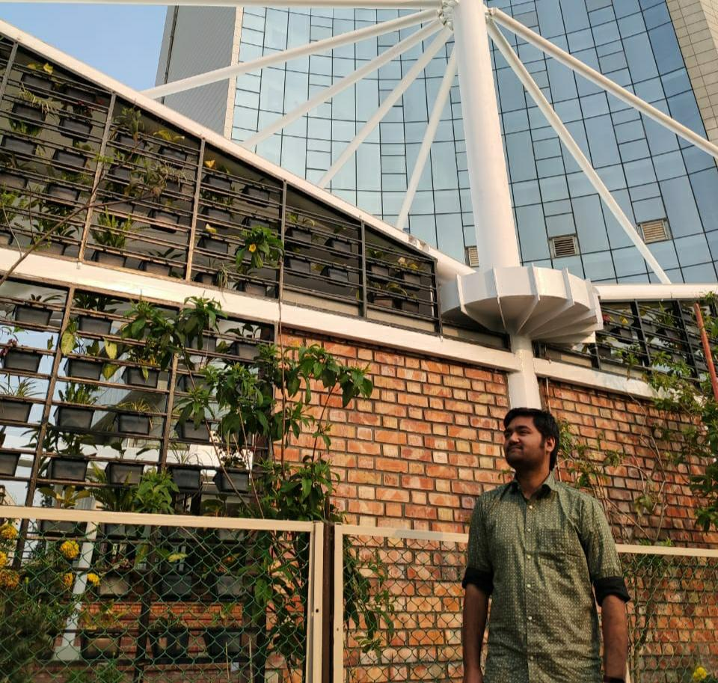

Sanad, Zarif Amir Islam, MD. Ifthe Kharul Chisty, MD. Nomanuzzaman Kajol, Ashesh Talukdar
ID- 19-41742-3 ID- 19-40447-1 ID- 19-40431-1 ID- 19-40459-1
Project Details
ADMIN
Objective &
Motivation
ADMIN
BUYER
Visitor
Group
Members
SELLER
CONTRIBUTION
FUNCTIONALITIES

Slide 3
Objective: Our objective is that through this code we can help those who need to buy or sell property. And one can buy or sell their property without much hassle compared to other alternatives. Also since the selling is done by bidding one can expect to get the best price possible. They can also get the general idea of the demand of different types of property. Also there are little to no chances of fraud or abuse since we maintain strict rules. This code will create a reliable platform on which people can trust and Buy or sell without worries about fraud and theft.
Motivation: Through this platform when someone buys or sells a piece of Property we take a small amount of money from buyer and seller. From the seller we take a small amount as promotion fee for promoting the property and from the buyer we take a token fee which will allow the buyer to bid for the property. And this money will allow us to make profit and also expand our business.
Group
Members
Objective &
Motivation
ADMIN
Project Details
ADMIN
BUYER
Visitor
SELLER
CONTRIBUTION
FUNCTIONALITIES

Slide 4
VISITOR: A visitor can visit our site and can see how the site work and what is its feature but cannot do any thing. For that visitor have to open a account under the buyer or seller division.
BUYER : A buyer can bid in the system and if he is the highest bidder he can own the property.
SELLER : A seller can sell property and can fixed the starting bid of the property.
ADMIN : Admin can add buyer and seller. He can see property and bid
history. Can see peoples complain. add property for sell. And open and close bid.
Group
Members
Project Details
Objective &
Motivation
ADMIN
ADMIN
BUYER
Visitor
SELLER
CONTRIBUTION
FUNCTIONALITIES

Slide 5
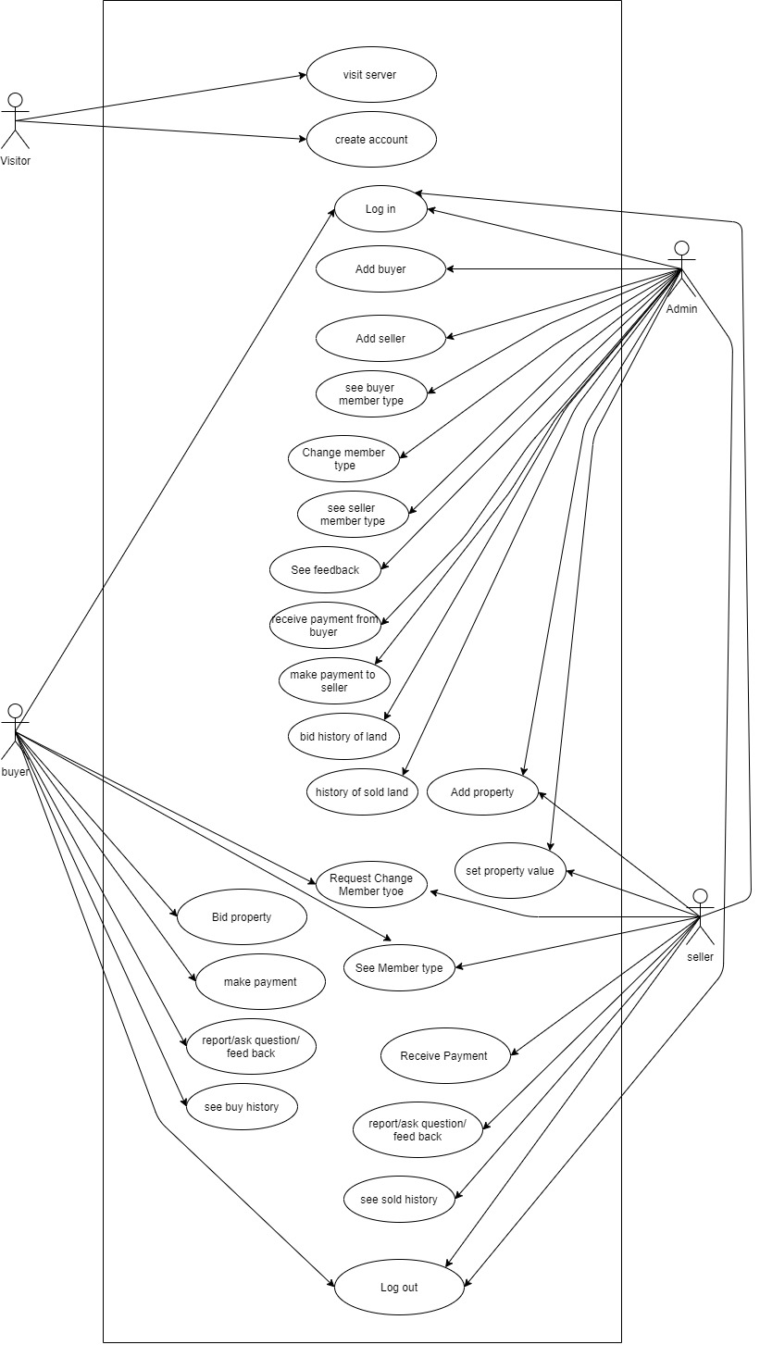
Every Functionalities in this Project is Based on this Diagram. We included the drive link also if anyone want a better viewing.
Link- https://drive.google.com/file/d/1CBhw4Hdvpeq-ii_C40nyy6HfCDE7zjWk/view?usp=sharing
Group
Members
Objective &
Motivation
Project Details
ADMIN
ADMIN
BUYER
Visitor
FUNCTIONALITIES
SELLER
CONTRIBUTION

Slide 6
Visitor is a non-user person to our System.
Visit Server: One can see what our website/server has.
Create Account: One can create an new account.
Objective &
Motivation
Visit Server
Project Details
Group
Members
ADMIN
FUNCTIONALITIES
ADMIN
Visitor
BUYER
SELLER
CONTRIBUTION
Create Account
Visitor

Slide 7
Add Seller
See Buyer member type
Login
Add Buyer
See Seller member type
Log Out
Change member type
Admin
Group
Members
Set property value
Objective &
Motivation
Project Details
ADMIN
ADMIN
Visitor
BUYER
FUNCTIONALITIES
SELLER
CONTRIBUTION
See Feedback
Add property
History of Sold property
Receive payment from buyer
Make payment to seller
Bid history of property

Slide 8
Log in: Using existing admin username and password one can access our system
Add Buyer: This method will be used to add a buyer to main server.
Add seller: This method will be used to add a seller to main server
See Buyer Member Type: Admin can see member type.
See Seller Member Type: Admin can see member type.
Change member Type: Admin can change a user type from normal user to Premium or Silver or Bronze. Premium to silver or bronze or Normal. Silver to Premium or bronze or Normal. Bronze to silver or Premium or Normal.
See Feedback: A Member can send feedback about our system.
Receive Payment from Buyer: As it is bidding system a buyer pay his/her money through our system
Make Payment to seller: After taking promotion fee our system pay the bidding money to its seller.
Group
Members
Objective &
Motivation
Project Details
ADMIN
Visitor
BUYER
ADMIN
FUNCTIONALITIES
SELLER
CONTRIBUTION

Slide 9
Bid history of property: In property bidding an admin can see how many bids on that particular property have been made.
History of sold property: An Admin can see How many property’s have been sold.
Add property: Admin can add there property to listing.
Set property Value: Admin can set property’s minimum value.
Logout: After necessary work is done Admin can logout from the system.
Group
Members
Objective &
Motivation
ADMIN
Project Details
ADMIN
Visitor
BUYER
FUNCTIONALITIES
SELLER
CONTRIBUTION

Slide 10
Bid property
Make Payment
Login
Member type
Buyer
Group
Members
Log Out
Objective &
Motivation
Project Details
ADMIN
FUNCTIONALITIES
ADMIN
SELLER
BUYER
Visitor
CONTRIBUTION
Request change member type
See buy History
Report/ Ask Question/ Feedback

Slide 11
Login: After creating a buyer account, he/she can access that account by using username and password.
Bid property: a buyer can bid to buy a property.
Make payment: After wining in bidding Buyer has to make his/her payment.
Member Type: He/ She can see his/her member type.
Request Change Member Type: after spending a certain amount of money buyer can upgrade their member type.
Report/ Ask question / Feedback: If a buyer has any question about bidding process or anything he/she can ask. Also can report if there is any unusual activity. Also can give feedback.
See buy History: A buyer can see his entire buying history
Log out: After buying a property or after bidding a buyer can sign out from his/her account.
Group
Members
Objective &
Motivation
Project Details
ADMIN
FUNCTIONALITIES
ADMIN
SELLER
BUYER
Visitor
CONTRIBUTION

Slide 12
Add Property
Set Property Value
See Member Type
Login
Seller
Request Change Member Type
Group
Members
Objective &
Motivation
ADMIN
Project Details
BUYER
SELLER
ADMIN
Visitor
Log Out
FUNCTIONALITIES
CONTRIBUTION
Report/ Ask Question/ Feedback
See Sold History

Slide 13
Login: After creating a Seller account, he/she can access that account by using username and password.
Add property: Seller can add there property to be sold.
Set property Value: Seller can add there property’s minimum value or starting bid.
See Member Type: He/ She can see his/her member type.
Request Change Member Type: after selling a certain amount of property seller can upgrade their member type.
Report/ Ask question / Feedback: If a Seller has any question about bidding process or anything else he/she can ask. Also can report if there is any unusual activity. Also can give feedback.
See Sold History: A Seller can see his entire Selling history.
Log out: After buying a property or after bidding a buyer can sign out from his/her account.
Group
Members
Objective &
Motivation
ADMIN
Project Details
BUYER
SELLER
ADMIN
Visitor
FUNCTIONALITIES
CONTRIBUTION

Slide 14
Member’s Name | Contribution (Methods)
Zarif Amir Sanad | Visitor( Visit Server) ADIMN( Log in, Add Buyer, Add seller, See Buyer Member Type, See seller Type, Change Member Type, See Feedback)
MD. Ifthe Kharul Islam | ADMIN( Receive Payment From Buyer, Make Payment to seller, Bid History of Property, History of Sold Property, Add Property, Set Property Value, Log Out) BUYER(Login)
Group
Members
Objective &
Motivation
ADMIN
Project Details
BUYER
SELLER
ADMIN
Visitor
CONTRIBUTION
FUNCTIONALITIES

Slide 15
Member’s Name | Contribution (Methods)
MD. Nomanuzzaman Chisty | Visitor( Create Account) BUYER( Bid Property, Make Payment, Member Type, Request Change Member Type, Report/ Ask Question/ Feedback, See Buy History, Log Out)
Kajol Ashesh Talukdar | SELLER( Login, Add Property, Set Property Value, See Member Type, Request Change Member Type, Report/ Ask Question/ Feedback, See Sold History, Log Out)
Group
Members
Objective &
Motivation
ADMIN
Project Details
BUYER
SELLER
ADMIN
Visitor
CONTRIBUTION
FUNCTIONALITIES

Slide 16
1. We made changes in visitor function. We added dashboard on this function where it shows time, sold history & images, Contract & About us.
2. In admin we added admin settings where an admin can update his/her details like he/she can change image, phone number, name, password and so on. But as previously planed we cannot added few functions like change member type and see feedback . 3. In buyer we added setting and add fund. In setting a buyer can change his personal information. In add fund a buyer can add money in his/her wallet from some online banking services. Also we cannot added request change member type and report/ ask question/ feedback as we planned. 4. In seller we added refresh and settings. By using refresh button a seller can see what is the latest bid of his/her property. In settings button a seller can change his/her personal details. Also we cannot added request change member type and report/ask question/ feedback as we planned.
Group
Members
Objective &
Motivation
ADMIN
Project Details
BUYER
Changes
ADMIN
SELLER
Visitor
FUNCTIONALITIES

Slide 17
1. We have completed this project within a short time. So that there
will be some bugs or mistakes.
2. Admin cannot communicate with seller or buyer.
3. There is no Feedback system.
4. No cloud system to work in multiple device. 5. Because of group project we have to give zip file of this project
multiple times to one another.
Group
Members
Objective &
Motivation
ADMIN
Project Details
BUYER
SELLER
ADMIN
Visitor
Drawbacks & Limitations
FUNCTIONALITIES

Slide 18
1. Firstly in future we will implement every function as we planned. 2. In dashboard we want to implement a function where we can see evey details
about property which is up for sell not only just sold property. 3. In admin we will try to implement more function where an admin can
control everything in a Property bidding. Also we will try to improve our
payment system where a buyer and seller get the invoice. 4. Most importantly we will try to make a chatting system where a buyer
/ seller can chat with each other also they can chat with admin.
5. Also we want to add a function where an admin can change a
seller/ buyer member type from general to premium or VIP based on their activity on our system.
Group
Members
Objective &
Motivation
ADMIN
Project Details
BUYER
SELLER
ADMIN
Visitor
Future Works
FUNCTIONALITIES

Slide 19
Our project goal was to make an easier bidding system for people who can
sell and buy property from our system. First of all as we planned we try
implement every function. Fortunately we did implement most of the function
as we planned and it work as we expected. First we work on dashboard and
admin class. Then we work on seller and buyer Class. In seller class we try to
make sure a seller can add a property and set a minimum value of that property
also a seller can change his personal details. A seller also can see his/her
sold history. Likewise in buyer class a buyer can bid a selected property and a
buyer can add balance using online banking service through our system. Now
in admin class an admin can see buyer/ seller information also admin can see
see history of sold items. Most important part for admin is to make
payment Also an admin can modify his/her personal details by using
settings button. Finally we can say that our project goal
is achieved and it works perfectly as we planned in the beginning.
Group
Members
Objective &
Motivation
ADMIN
Project Details
BUYER
SELLER
ADMIN
Review
Visitor
FUNCTIONALITIES

Slide 20
Everything in the world has its own two slides,the internet is no exception.The internet is ultimately more beneficial than detrimental to people.
Thank You
Group
Members
Objective &
Motivation
ADMIN
Project Details
BUYER
SELLER
ADMIN
Visitor
CONTRIBUTION
FUNCTIONALITIES

